Slide 1
Time Series Analysis
Basics of Time Series Analysis
Nicoleta Serban, Ph.D.
Associate Professor
Stewart School of Industrial and Systems Engineering
Basic Definition and Examples

Slide 2
About this lesson

Slide 3
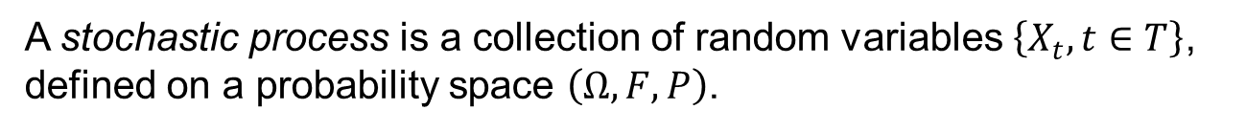
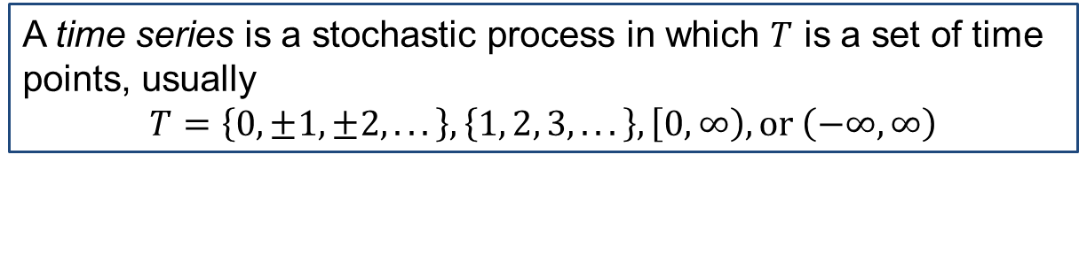
Formal Definition
A stochastic process is a collection of random variables $\left\{X_{t}, t∈T\right\}$, defined on a probability space $\left(Ω, F, P\right)$.
A time series is a stochastic process in which $T$ is a set of time points, usually
$$T=\left\{0, ±1, ±2, .. .\right\}, \left\{1, 2, 3, .. .\right\}, \left[0,\left.∞\right), \text{or} \left(−∞, ∞\right)\right.$$
Note: The term “time series” is also used to refer to the realization of such a process (observed time series).

Slide 4
Example: Time Series
Monthly sales of Australian red wine
Monthly accidental deaths in the U.S.
Daily Average Temperature from La Harpe station in Hancock County, Illinois
Daily stock price of IBM stock
US monthly interest rates
US yearly GDP
1-minute intraday S&P500 return

Slide 5
Time Series: Characteristics
Trend: long-term increase or decrease in the data over time
Seasonality: influenced by seasonal factors (e.g. quarter of the year, month, or day of the week)
Periodicity: exact repetition in regular pattern (seasonal series often called periodic, although they do not exactly repeat themselves)
Cyclical trend: data exhibit rises and falls that are not of a fixed period
Heteroskedasticity: varying variance with time
Dependence: positive (successive observations are similar) or negative (successive observations are dissimilar)

Slide 6
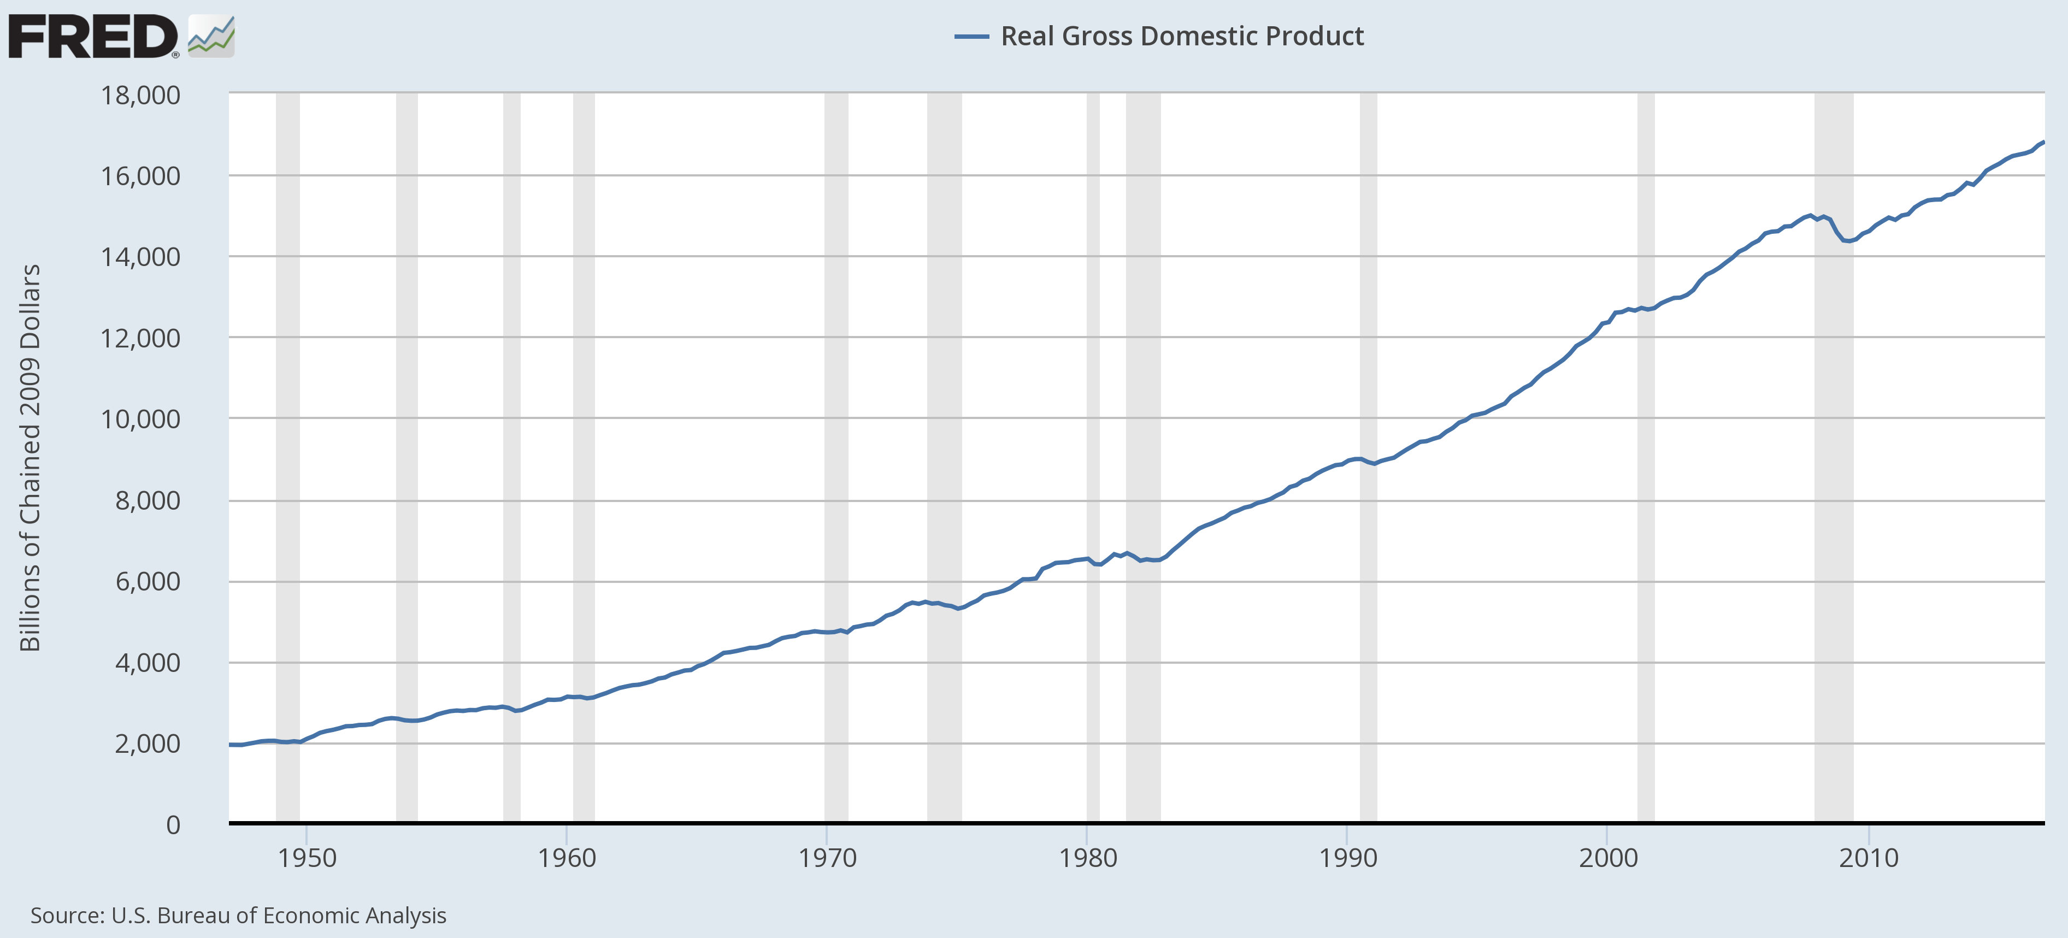
Example: GDP

Slide 7
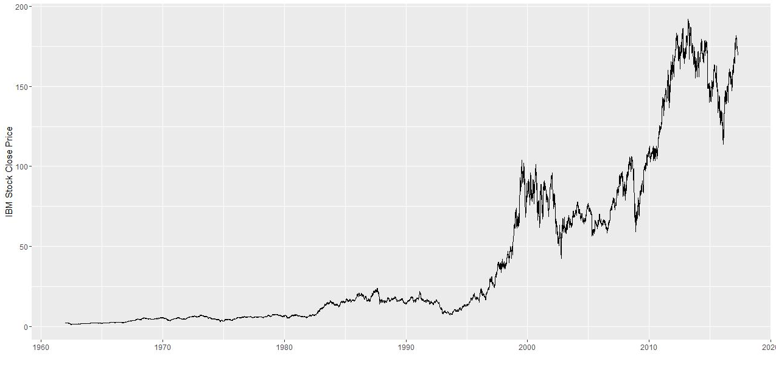
Example: Daily IBM Stock Price

Slide 8
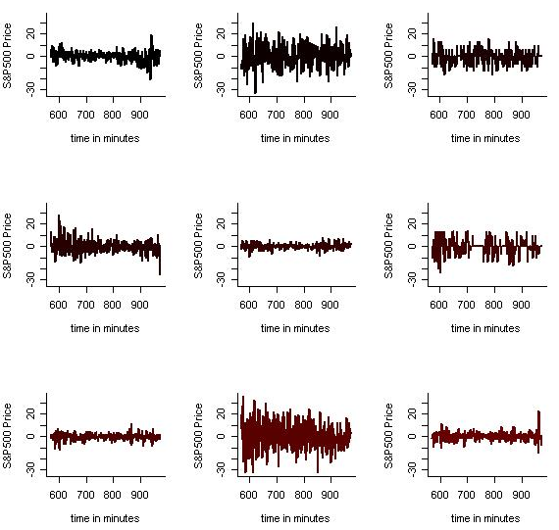
Example: S&P500 Intraday

Slide 9
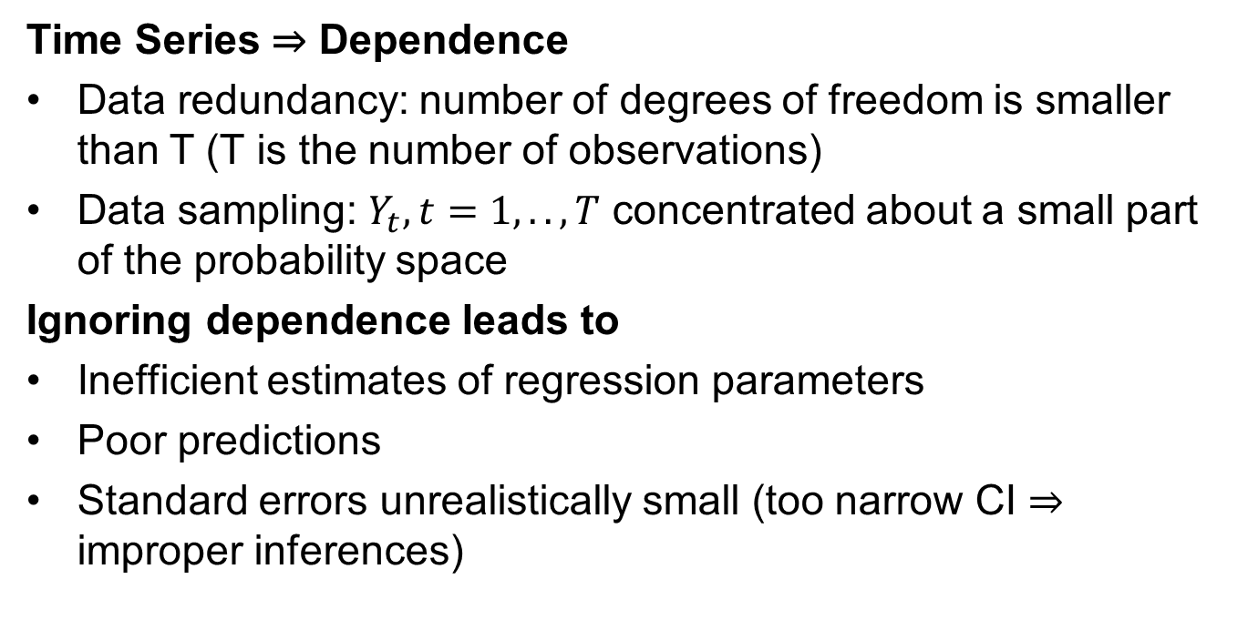
Is Time Series Analysis Necessary?
Time Series ⇒ Dependence
Data redundancy: number of degrees of freedom is smaller than T (T is the number of observations)
Data sampling: $Y_{t}, t=1,..,T$ concentrated about a small part of the probability space
Ignoring dependence leads to
Inefficient estimates of regression parameters
Poor predictions
Standard errors unrealistically small (too narrow CI ⇒ improper inferences)

Slide 10
Time Series: Objectives
Description
Plot the data and obtain simple descriptive measures of the
main properties of the series.
Explanation
Find a model to describe the time dependence in data.
Forecasting
Given a finite sample from the series (observations), forecast
the next value or the next several values.
Control/Tuning
After forecasting, adjust various control/tune parameters.

Slide 11
Time Series Analysis: Approaches
Time domain approach
Assume that correlation between adjacent points in time can be explained through dependence of the current value on past values.
Frequency domain approach
Characteristics of interest relate to periodic (systematic) sinusoidal variations in the data, often caused by biological, physical, or environmental phenomena.

Slide 12
Summary

